Slide 1
Accessibility for Live Presentations
Shawn Weisfeld
shawn.weisfeld@microsoft.com

Slide 2
Disclaimer
These are my thoughts
I am not an expert in accessibility
I am just a tech nerd trying to do what I can to make things better

Slide 3
Problem Statement
How do I increase accessibility for live presentations for those
with hearing difficulties
where English is not there first language
How do I increase engagement for folks who learn better by reading vs hearing?

Slide 4
Option: Higher Sign language interpreter
High fidelity transcription
Can be Expensive
Only helps folks that know sign language

Slide 5
Option: Add closed captions or subtitles in PowerPoint
Pre-create a WebVTT or TTML file that will play along with your presentation.
Not ideal for live presentations where the presenter goes off script.
Supported in Office 2010+
https://support.office.com/en-us/article/add-closed-captions-or-subtitles-in-powerpoint-df091537-fb22-4507-898f-2358ddc0df18

Slide 6
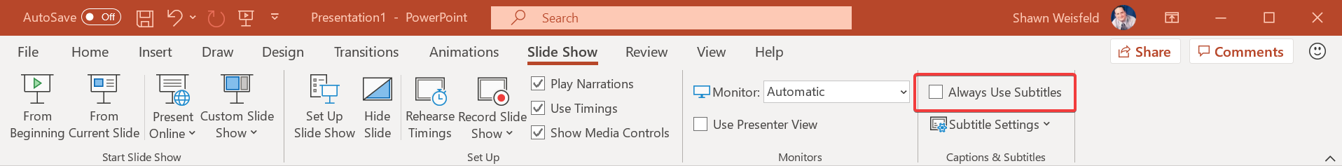
Option: Subtitles feature in PowerPoint
PowerPoint for Office 365 can transcribe your words as you present and display them on-screen as captions in the same language you are speaking, or as subtitles translated to another language.
In PowerPoint, when presenting, 1 in and 1 out language.
https://support.office.com/en-us/article/Present-with-real-time-automatic-captions-or-subtitles-in-PowerPoint-68d20e49-aec3-456a-939d-34a79e8ddd5f

Slide 7
Option: Microsoft Garage Presentation Translator
Live subtitling: Speak in any of the 10 supported speech languages – Arabic, Chinese (Mandarin), English, French, German, Italian, Japanese, Portuguese, Russian and Spanish – and subtitle into any one of the 60+ text translation languages.
Customized speech recognition: Presenters have the option to customize the speech recognition engine using the vocabulary within the slides and slide notes to adapt to jargon, technical terms, product or place names, etc.
Translate PowerPoint Text: Translate the text of PowerPoint while preserving the original formatting, including translation between left-to-right and right-to-left languages.
Audience Participation: Share a QR- or five letter conversation code and your audience can follow along with your presentation, on their own device, in their chosen language.
Open the mic to multi-lingual Q&A: Unmute the audience to allow questions in any of the supported languages (10 for spoken questions, 60+ for written ones).
Inclusivity through Accessibility: Help audience members who are deaf or hard of hearing follow the presentation, and participate in the discussion.
https://aka.ms/presentationtranslator

Slide 8
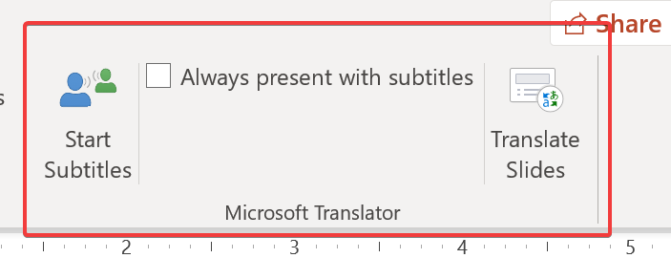
Option: Microsoft Garage Presentation Translator
Start with PowerPoint, but works outside of it.
Transcription can be customized.
1 in and many out languages on the user's device.
Unknown future, since they added a similar feature to PowerPoint.

Slide 9
Option: Custom solution built on Microsoft Cognitive Services
Requires more tech
Can be configure to not require any action/software by presenter or run on presenter's computer
Can be configured to translate to other languages (not implemented)
Costs $1 per hour
Sample Application:
https://github.com/shawnweisfeld/RealTimeClosedCaptioning2

Slide 10


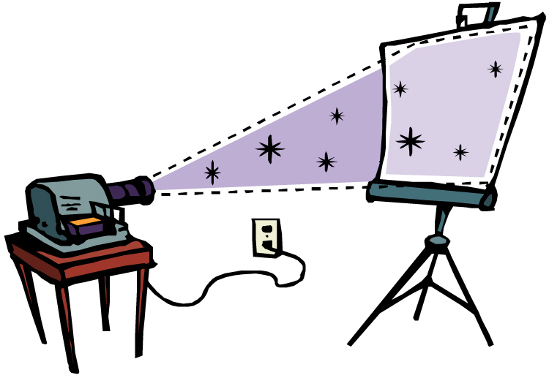

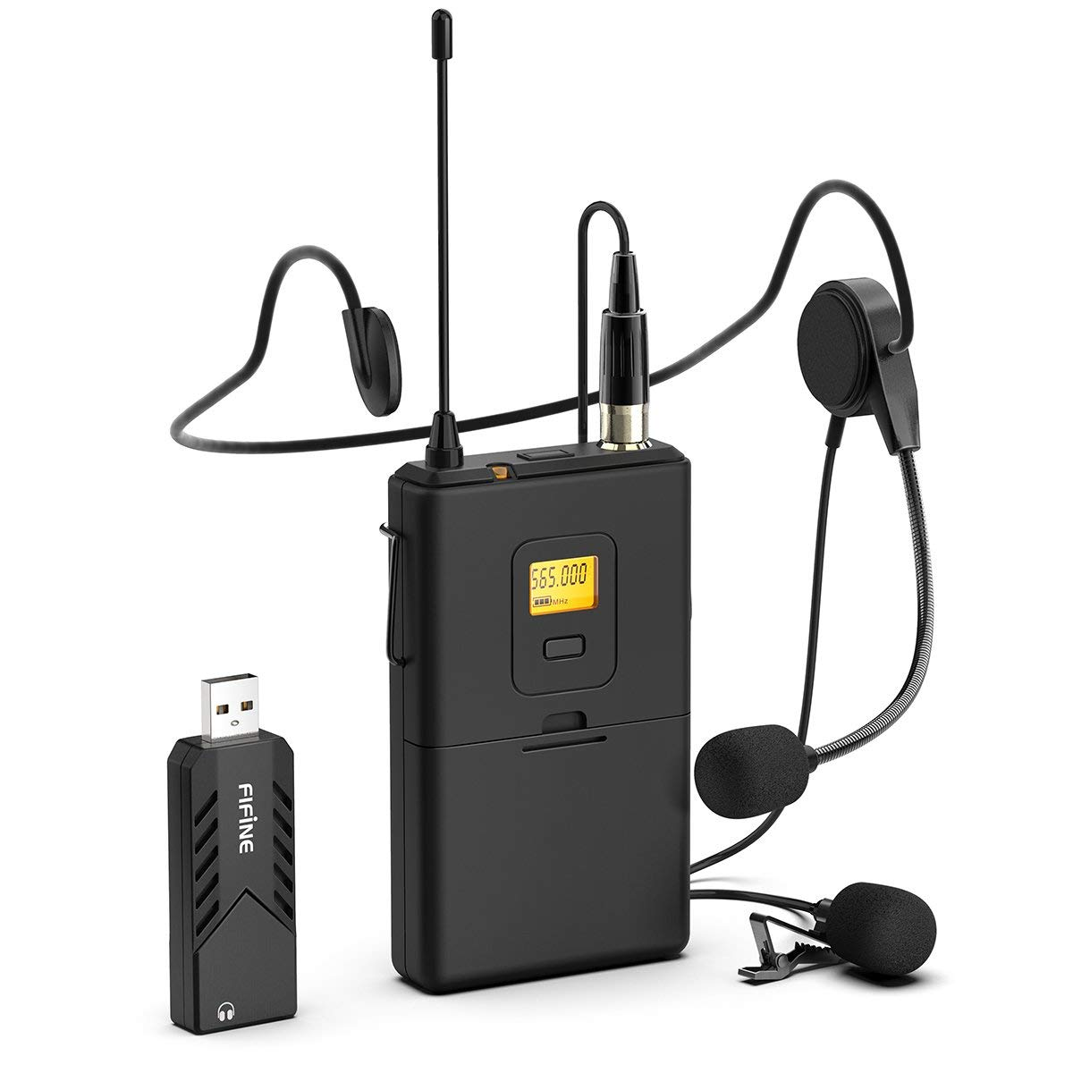
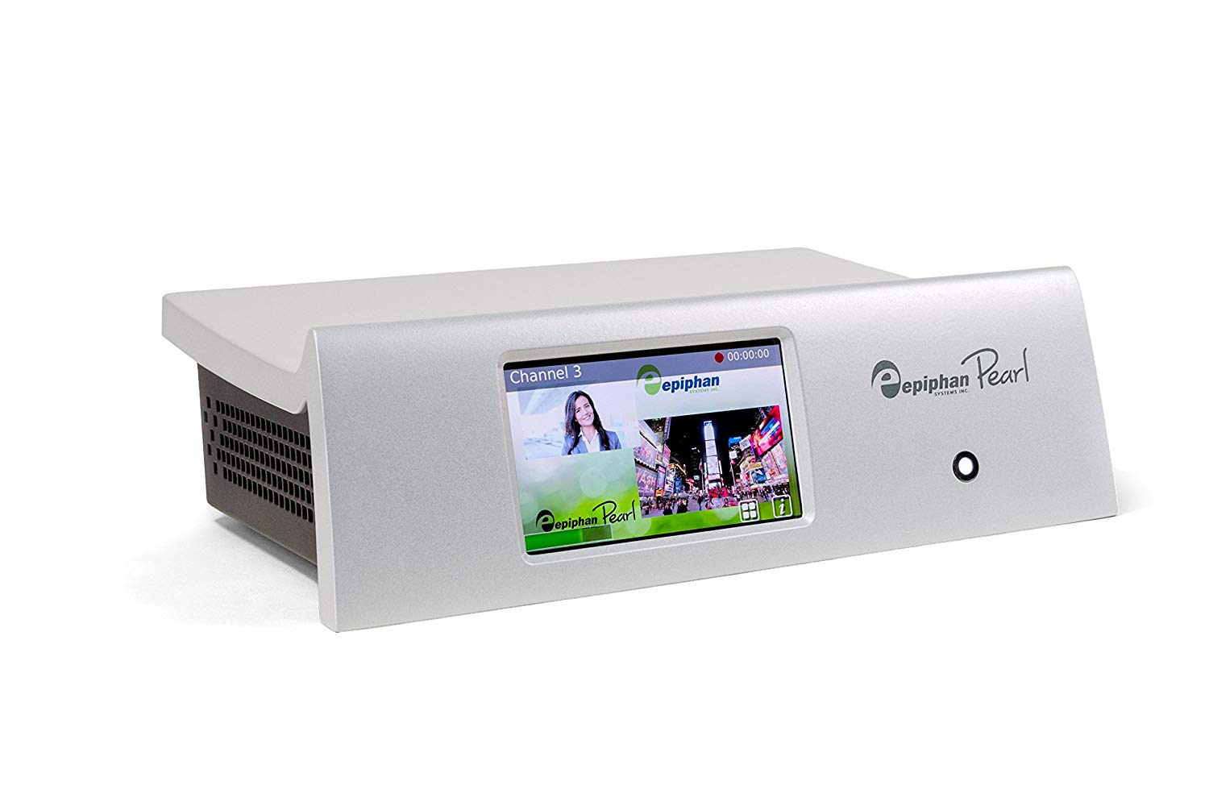
The setup…
All Audio
Presenter
5
Text
Transcription
Green Screen
HDMI
HDMI Audio
1
4
HDMI
All Audio
HDMI Audio
HDMI
6
Mic Audio
This Photo by Unknown Author is licensed under CC BY-SA-NC
3
2

Slide 11
The setup…
The presenter presents as they would do normally. Just connecting their computer to the HDMI connection.
The presenter also wears a lavalier microphone.
The presenter's computer and audio are captured into the Epiphan Pearl. Allowing me to:
Record the content
Stream the content online
Stream the content out to the projector
Combine the content with the output from the Transcription Green Screen Computer
The transcription green screen computer takes the audio from the Pearl, sends it to Azure to get transcribed, overlays the text transcription on a green screen to input back into the pearl.
The speech to text cognitive service in Azure takes the local audio and using AI converts it to text.
The projector takes the combined output from the pearl (the presenter's output and the transcription) and shares it with the local audience.

Slide 12

Green Screen

Slide 13
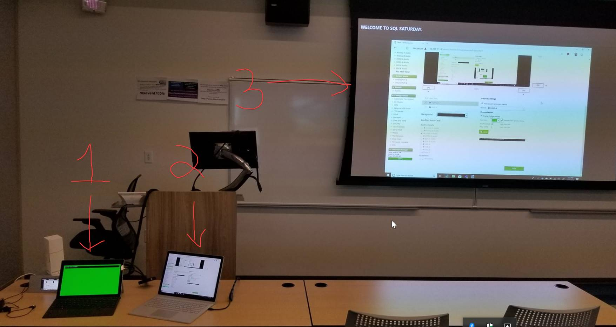
Composite Screen

Slide 14
Links
Make your PowerPoint presentations accessible to people with disabilities
https://support.office.com/en-us/article/make-your-powerpoint-presentations-accessible-to-people-with-disabilities-6f7772b2-2f33-4bd2-8ca7-dae3b2b3ef25
Use dictation to talk instead of type on your PC
https://support.microsoft.com/en-us/help/4042244/windows-10-use-dictation
Closed captioning in Teams
https://microsoftteams.uservoice.com/forums/555103-public/suggestions/18613726-captioning-on-audio-and-or-video-meetings-calls

